Slide 1

Deep Learning Assignment 1
Convolutional Neutral Network Analysis
Presented by:
Nicolas Teo Zhi Yong
S10206093

Slide 2
01
02
03
Overview
Development of Models
Data preprocessing and Loading
Contents
04
Application of Models

Slide 3
Overview
01
The problem, objective and approach

Slide 4
Problem
10,000 Images
10 Food classes
1 solution
Ceviche, Cheese Plate, CheeseCake, Croque Madame, Escargots, French Toast, Hot and Soup Soup, Miso Soup, Paella, Risotto
7500 Training images
2000 Validation images
500 Testing images
Mutliclass single-label classification problem

Slide 5
Objective
Highest Validation Accuracy
Prevent Overfitting
Whilst keeping image size same
Minimise overfitting of the graph as much as possible

Slide 6
Best Accuracies Achieved
81.2%
80%
99%
Highest Testing Accuracy
Highest Validation Accuracy
Highest Training Accuracy

Slide 7
Approach
Convolutional Neural Network
Hyperparameters
Universal Machine Learning Workflow
Extra Features
L1 and l2 kernel regularizers,
Dropout layers, Learning rate, Batch size
Conv2d and Maxpooling layers
Batch and Layer Normalization
Overfitting, Preventing overfitting, Fine Tuning

Slide 8
Universal Machine Learning Workflow
Mutliclass single-label classification problem
Defining the problem
Preparation of data
Scaling up model until it overfits
Regularizing model with hyperparameters

Slide 9
Data pre-processing and loading
02

Slide 10
Data Pre-processing and Loading
Imported all libraries on first Jupyter Notebook Cell
Used Data Augmentation
Artificially Increase available data set
Used given image processing file to only use 10 food classes of 101 available
Use of Image Generators
To feed images to keras

Slide 11
Development of Model
03
2 Built-From-Scratch Models and 1 PreBuilt Model

Slide 12
Model 1
Built from scratch

Slide 13
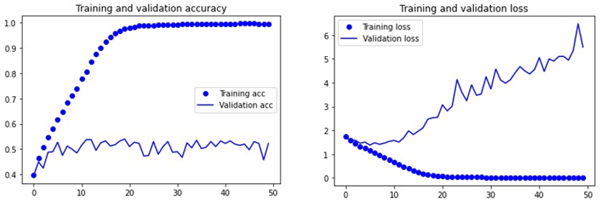
Built From Scratch
1
Model 1
(Overfitting)
Batch size 20
Conv2d 32 filters, Maxpooling(2,2)
Conv2d 64 filters, Maxpooling(3,3)
Conv2d 128 filters, Maxpooling(3,3)
Conv2d 128 filters, Maxpooling(3,3)
Flatten layer
Dense layer 512 neurons, relu activation
Dense layer 10 neurons, softmax activation.
RMSprop optimizers, 0.0001 learning rate
4 Sets of Conv2d and Max Pooling layers
Flatten Layer
2 Dense Layers
RMSProp optimizer

Slide 14
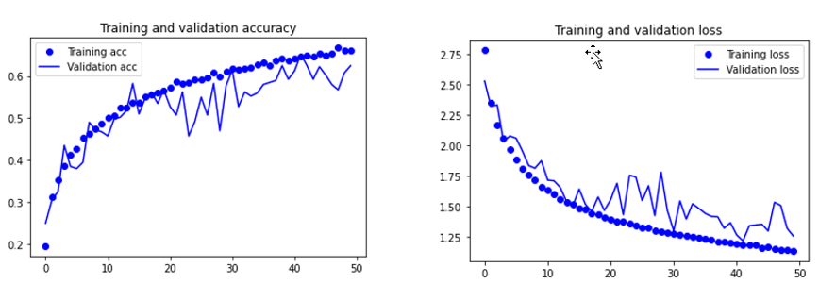
Built From Scratch
2
Model 1
(Prevent Overfitting)
Batch size 20
Conv2d 32 filters, Maxpooling(2,2)
Conv2d 64 filters, Maxpooling(3,3)
Conv2d 128 filters, Maxpooling(3,3)
Conv2d 128 filters, Maxpooling(3,3)
Dropout layer, 0.3
Flatten layer
Dense layer 512 neurons, relu activation
Dropout layer, 0.3
Dense layer 10 neurons, softmax activation. L2 kernel regularizer 0.001
RMSprop optimizers, 0.0001 learning rate
Changes Made:
To Prevent Overfitting:
Added 2 dropout layers with dropout rate of 0.3
Added L2 kernel regularizer 0.001

Slide 15
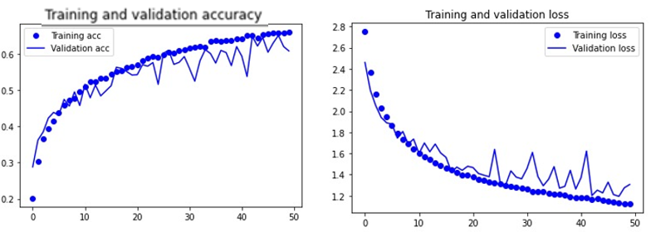
Built From Scratch
3
Model 1
(Prevent Overfitting)
Batch size 20
Conv2d 32 filters, Maxpooling(2,2)
Conv2d 64 filters, Maxpooling(3,3)
Conv2d 128 filters, Maxpooling(3,3)
Conv2d 128 filters, Maxpooling(3,3)
Dropout layer, 0.3
Flatten layer
Dense layer 512 neurons, relu activation
Dropout layer, 0.3
Dense layer 10 neurons, softmax activation. L2 kernel regularizer 0.001
RMSprop optimizers, 0.0005 learning rate
Changes Made:
To minimize fluctuations
Learning Rate decreased from 0.0001 to 0.00005

Slide 16
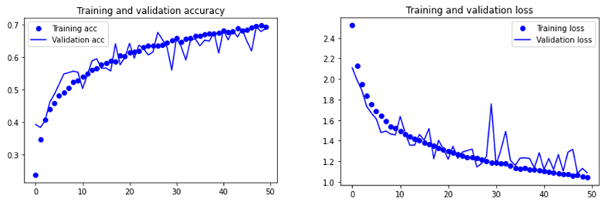
Built From Scratch
4
Model 1
(Prevent Overfitting)
Batch size 10
Conv2d 32 filters, Maxpooling(2,2)
Conv2d 64 filters, Maxpooling(3,3)
Conv2d 128 filters, Maxpooling(3,3)
Conv2d 128 filters, Maxpooling(3,3)
Flatten layer
Dense layer 512 neurons, relu activation
Dropout layer, 0.3
Dense layer 10 neurons, softmax activation. L2 kernel regularizer 0.001
RMSprop optimizers, 0.0005 learning rate
Changes Made:
To increase validation accuracy
Batch size decreased from 20 to 10
One dropout layer removed

Slide 17
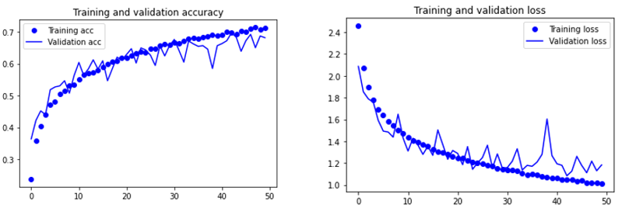
Built From Scratch
5
Model 1
(Prevent Overfitting)
Batch size 10
Conv2d 32 filters, Maxpooling(2,2)
Conv2d 64 filters, Maxpooling(3,3)
Conv2d 128 filters, Maxpooling(3,3)
Conv2d 128 filters, Maxpooling(3,3)
Flatten layer
Dense layer 512 neurons, relu activation
Dense layer 10 neurons, softmax activation. L2 kernel regularizer 0.001
RMSprop optimizers, 0.0005 learning rate
Changes Made:
As previous graph is of good fit
One dropout layer removed

Slide 18
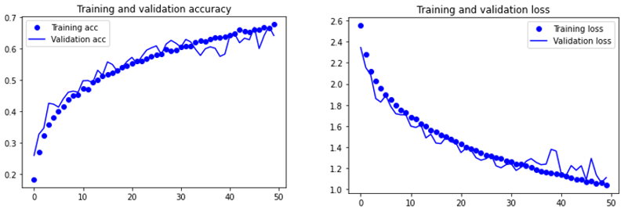
Built From Scratch
6
Model 1
(Prevent Overfitting)
Batch size 20
Conv2d 32 filters, Maxpooling(2,2)
Conv2d 64 filters, Maxpooling(3,3)
Conv2d 128 filters, Maxpooling(3,3)
Conv2d 128 filters, Maxpooling(3,3)
Flatten layer
Dense layer 512 neurons, relu activation
Dense layer 10 neurons, softmax activation. L2 kernel regularizer 0.001
RMSprop optimizers, 0.0005 learning rate
Changes Made:
As previous graph had fluctuations, to reduce fluctuations
Batch sized increased from 10 to 20

Slide 19
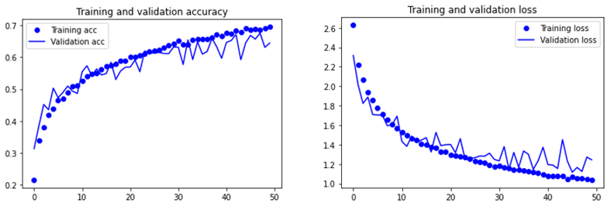
Built From Scratch
7
Model 1
(Prevent Overfitting)
Batch size 20
Conv2d 32 filters, Maxpooling(2,2)
Conv2d 64 filters, Maxpooling(3,3)
Conv2d 128 filters, Maxpooling(3,3)
Conv2d 128 filters, Maxpooling(3,3)
Flatten layer
Dense layer 512 neurons, relu activation
Dense layer 10 neurons, softmax activation. L2 kernel regularizer 0.001
RMSprop optimizers, 0.003 learning rate
Changes Made:
As previous graph has an increasing trend
Increased learning rate to 0.003 from 0.0005

Slide 20
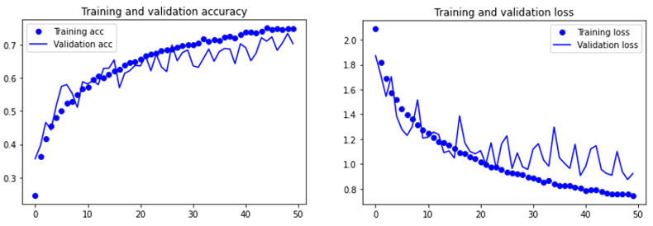
Built From Scratch
8
Model 1
(Prevent Overfitting)
Batch size 20
Conv2d 32 filters, Maxpooling(2,2)
Conv2d 64 filters, Maxpooling(3,3)
Conv2d 128 filters, Maxpooling(3,3)
Conv2d 128 filters, Maxpooling(3,3)
Dropout layer 0.3
Flatten layer
Dense layer 512 neurons, relu activation
Dense layer 10 neurons, softmax activation
RMSprop optimizers, 0.0002 learning rate
Changes Made:
As previous graph has an increasing trend
L2 kernel regularizer removed
Learning Rate decreased
Dropout layer of dropout rate 0.3 added

Slide 21
Model 2
Built from scratch

Slide 22
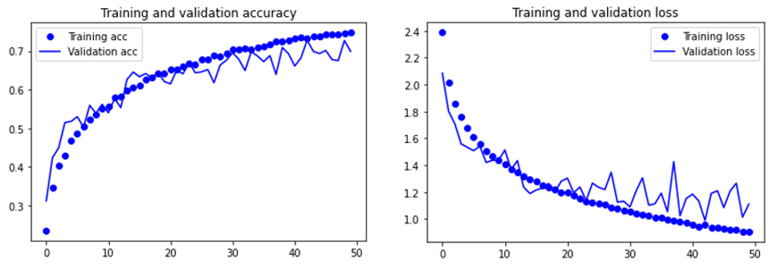
Built From Scratch
1
Model 2
(Overfitting)
Batch size 20
Conv2d 32 filters, Conv2d 64 filters, Maxpooling(2,2)
Conv2d 128 filters, Conv2d 128 filters, Maxpooling(3,3)
Conv2d 128 filters, Conv2d 128 filters, Maxpooling(3,3)
Dense layer 512 neurons, relu activation
Flatten layer
Dense layer 10 neurons, softmax activation
RMSprop optimizers, 0.001 learning rate
3 Sets of Conv2d, Conv2d and Max Pooling layers
Flatten Layer
2 Dense Layers
RMSProp optimizer

Slide 23
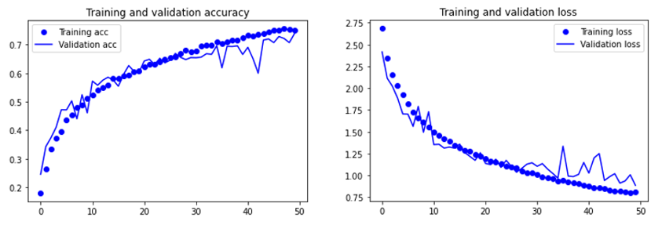
Built From Scratch
2
Model 2
(Overfitting)
Batch size 20
Conv2d 32 filters, Conv2d 64 filters, Maxpooling(2,2)
Conv2d 128 filters, Conv2d 128 filters, Maxpooling(3,3)
Conv2d 128 filters, Conv2d 128 filters, Maxpooling(3,3)
Conv2d 128 filters, Conv2d 128 filters, Maxpooling(3,3)
Flatten layer
Dense layer 512 neurons, relu activation
Dense layer 10 neurons, softmax activation
RMSprop optimizers, 0.001 learning rate
Changes Made:
To increase network size due to increasing trend
Added another set of Conv2d, Conv2d and Maxpooling layer

Slide 24
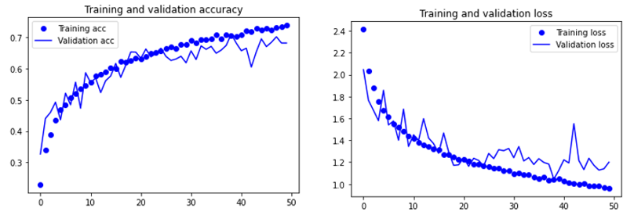
Built From Scratch
3
Model 2
(Prevent Overfitting)
Batch size 20
Conv2d 32 filters, Conv2d 64 filters, Maxpooling(2,2)
Conv2d 128 filters, Conv2d 128 filters, Maxpooling(3,3)
Conv2d 128 filters, Conv2d 128 filters, Maxpooling(3,3)
Flatten layer
Dense layer 512 neurons, relu activation
Dense layer 10 neurons, softmax activation, l2 kernel regularizer 0.0001
RMSprop optimizers, 0.0001 learning rate
Changes Made:
Removed extra set of Conv2d, conv2d and maxpooling layer
Added kernel regularizer of 0.0001

Slide 25
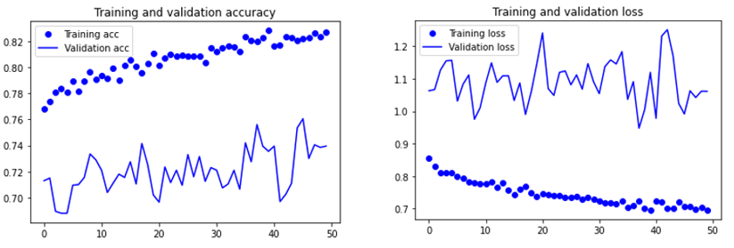
Built From Scratch
4
Model 2
(Prevent Overfitting)
Batch size 20
Conv2d 32 filters, Conv2d 64 filters, Maxpooling(2,2)
Conv2d 128 filters, Conv2d 128 filters, Maxpooling(3,3)
Conv2d 128 filters, Conv2d 128 filters, Maxpooling(3,3)
Flatten layer
Dense layer 512 neurons, relu activation
Dense layer 10 neurons, softmax activation, l2 kernel regularizer 0.0001
RMSprop optimizers, 0.00005 learning rate
Changes Made:
Lowered learning rate from 0.0001 to 0.00005

Slide 26
MobileNetV2
Prebuilt Model

Slide 27
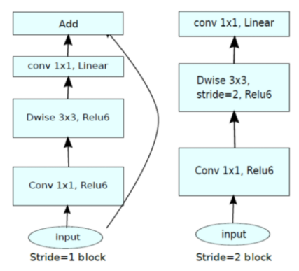
What is MobileNetV2
3 layer model
2 types of blocks
Lightweight model
16 blocks,
First layer 1x1 convolution
Second layer depth wise convolution
Third layer 1x1 convolution without any non-linearity
14 MB in size

Slide 28
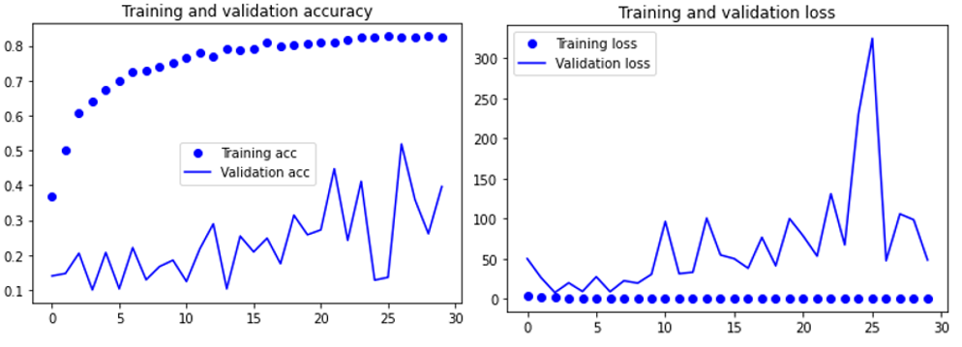
Prebuilt Model
1
MobileNetV2
(Overfitting)
Batch size 20
Dense layer 512 neurons, relu activation
Dense layer 10 neurons, softmax activation
RMSprop optimizers, 0.001 learning rate
MobileNetV2 (No fine tuning)
Flatten layer
MobileNetV2 with imagenet weights
Flatten Layer
2 Dense Layers
RMSProp optimizer

Slide 29
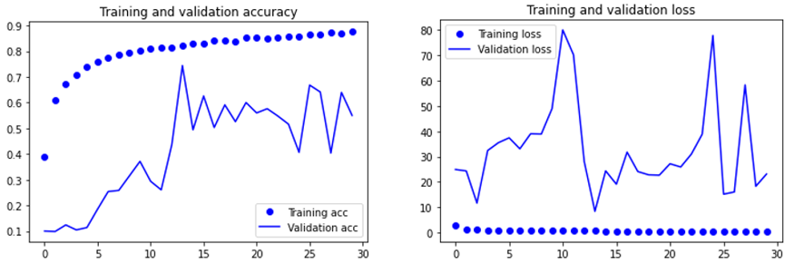
Prebuilt Model
2
MobileNetV2
(Overfitting)
Batch size 20
Dense layer 256 neurons, relu activation
Dense layer 10 neurons, softmax activation
RMSprop optimizers, 0.001 learning rate
MobileNetV2 (No fine tuning)
Flatten layer
Changes Made:
Dense layer neurons decreased from 512 to 256

Slide 30
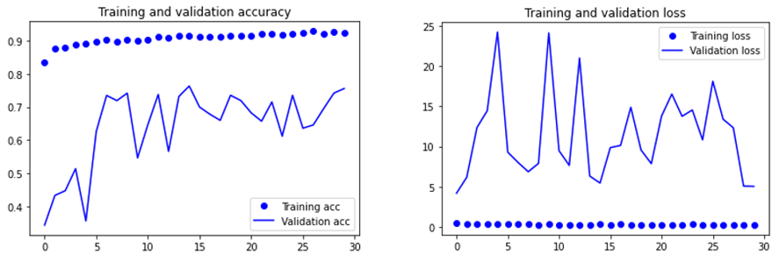
Prebuilt Model
3
MobileNetV2
(Fine Tuning)
Batch size 20
Dense layer 256 neurons, relu activation
Dense layer 10 neurons, softmax activation
RMSprop optimizers, 0.001 learning rate
MobileNetV2 (Unlocked Block 16)
Flatten layer
Changes Made:
Unlocked Block 16

Slide 31
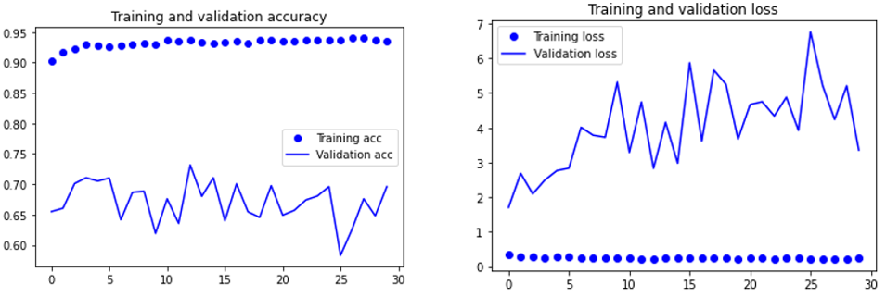
Prebuilt Model
4
MobileNetV2
(Fine Tuning)
Batch size 20
Dense layer 256 neurons, relu activation
Dense layer 10 neurons, softmax activation
RMSprop optimizers, 0.001 learning rate
MobileNetV2 (Unlocked Block 15,16)
Flatten layer
Changes Made:
Unlocked Block 15

Slide 32
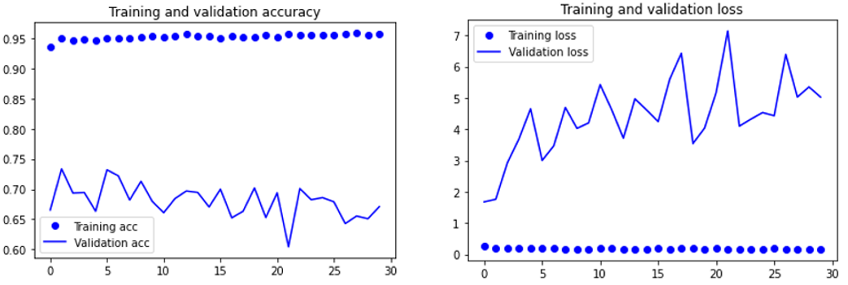
Prebuilt Model
5
MobileNetV2
(Fine Tuning)
Batch size 20
Dense layer 256 neurons, relu activation
Dense layer 10 neurons, softmax activation
MobileNetV2 (Unlocked Block 15,16)
Flatten layer
Dropout layer, 0.3
RMSprop optimizers, 0.001 learning rate
Changes Made:
Added dropout layer of dropout rate 0.3

Slide 33
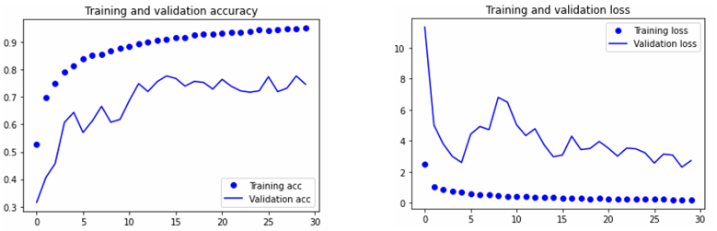
Prebuilt Model
6
MobileNetV2
(Fine Tuning)
Batch size 20
Dense layer 256 neurons, relu activation
Dense layer 10 neurons, softmax activation
MobileNetV2 (Unlocked Block 14,15,16)
Flatten layer
Dropout layer, 0.3
RMSprop optimizers, 0.001 learning rate
Changes Made:
Unlocked Block 14

Slide 34
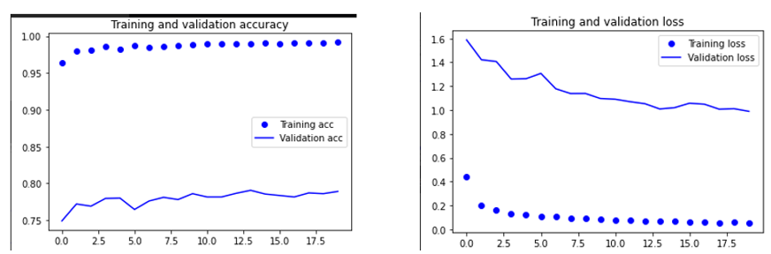
Prebuilt Model
7
MobileNetV2
(Prevent Overfitting using Batch Normalization)
Batch size 20
Dense layer 256 neurons, relu activation
MobileNetV2 (Unlocked Block 14,15,16)
Flatten layer
Batch Normalization
Dense layer 10 neurons, softmax activation
RMSprop optimizers, 0.001 learning rate
Changes Made:
Batch Normalization added

Slide 35
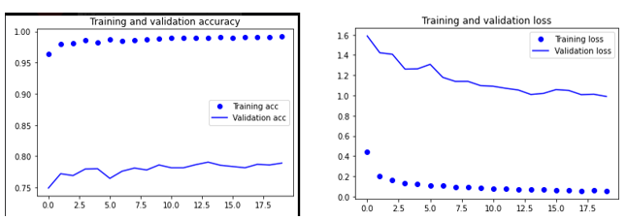
Prebuilt Model
8
MobileNetV2
(Prevent Overfitting using Batch Normalization)
Batch size 20
Dense layer 256 neurons, relu activation, l2 regularizer 0.003
MobileNetV2 (Unlocked Block 14,15,16)
Flatten layer
Dropout layer, 0.35
Batch Normalization
Dense layer 10 neurons, softmax activation, l2 regularizer 0.003
RMSprop optimizers, 0.0001 learning rate
Changes Made:
Added Dropout layer of dropout rate 0.35
Added 2 l2 regularizer of 0.003
Decreased learning rate to 0.0001

Slide 36
Prebuilt Model
9
MobileNetV2
(Prevent Overfitting using Layer Normalization)
Batch size 20
Dense layer 256 neurons, relu activation
MobileNetV2 (Unlocked Block 14,15,16)
Flatten layer
Layer Normalization
Dense layer 10 neurons, softmax activation
RMSprop optimizers, 0.001 learning rate
Changes Made:
Layer Normalization added

Slide 37
Prebuilt Model
10
MobileNetV2
(Prevent Overfitting using Layer Normalization)
Batch size 20
Dense layer 256 neurons, relu activation, l2 regularizer 0.01
MobileNetV2 (Unlocked Block 14,15,16)
Flatten layer
Dropout layer, 0.30
Layer Normalization
Dense layer 10 neurons, softmax activation, l2 regularizer 0.01
RMSprop optimizers, 0.001 learning rate
Changes Made:
Added Dropout layer of dropout rate 0.30
Added 2 l2 regularizer of 0.01

Slide 38
Application of Models
04

Slide 39
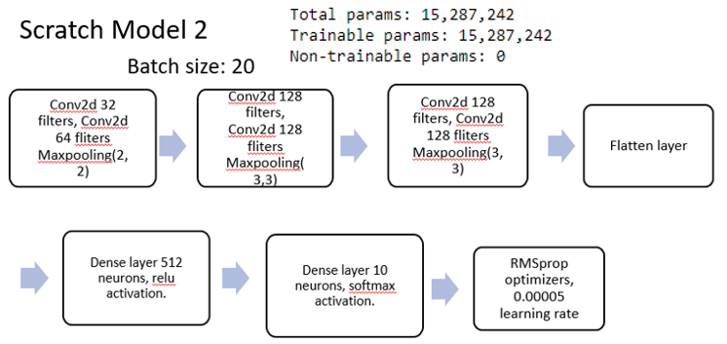
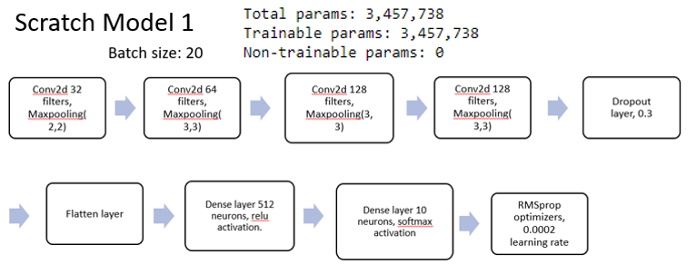
Application of Models
Finding the Best Model
5 Models:
2 Scratch models
3 MobileNetV2 models

Slide 40
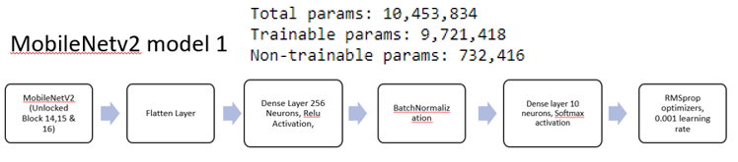
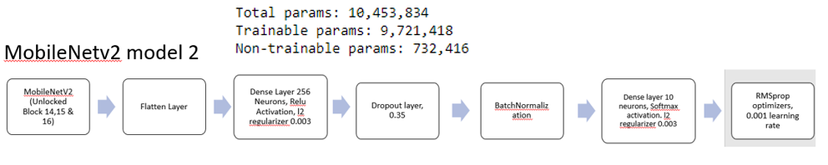
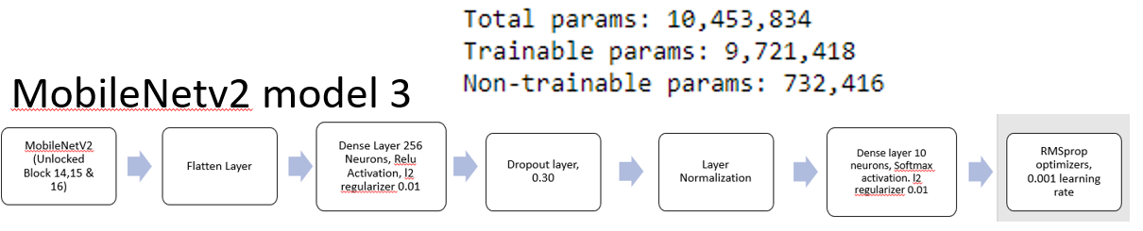
Application of Models
Finding the Best Model
MobileNetV2 model 1 uses Batch Normalization
MobileNetV2 model 1 uses Batch Normalization with Dropout Layer
MobileNetV2 model 1 uses Layer Normalization

Slide 41
Application of Models
Model | Test accuracy | Total parameters
Scratch Model 1 | 0.7160 | 3,457,738
Scratch Model 2 | 0.720 | 15,287,242
MobileNetV2 Model 1 | 0.812 | 10,453,834
MobileNetV2 Model 2 | 0.798 | 10,453,834
MobileNetV2 Model 3 | 0.770 | 10,453,834
Finding the Best Model (Results)

Slide 42
Application of Models
Best Model
- MobileNetV2 model 1 was chosen as it had the highest test accuracy
Model | Test accuracy | Total parameters
Scratch Model 1 | 0.7160 | 3,457,738
Scratch Model 2 | 0.720 | 15,287,242
MobileNetV2 Model 1 | 0.812 | 10,453,834
MobileNetV2 Model 2 | 0.798 | 10,453,834
MobileNetV2 Model 3 | 0.770 | 10,453,834

Slide 43
Application of Models
04
Test on Real-World Images

Slide 44
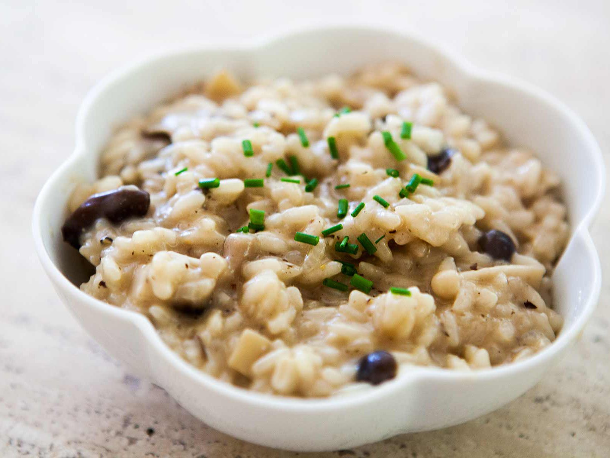
Application of Models
Test Application
Risotto
Risotto
Model Prediction: 0.546
Ceviche
Model Prediction: 0.410

Slide 45
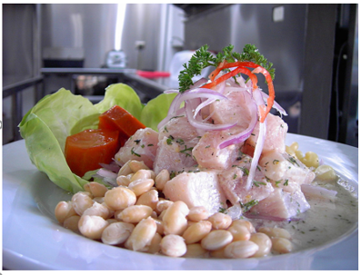
Application of Models
Reasons for Inconsistencies
Ceviche
- Similar Features
- Similar colour
-Similar shape and texture
Risotto

Slide 46

Application of Models
Test Application
Miso Soup
Model Prediction: 1.0
Ceviche
Model Prediction: 3.037e-08

Slide 47
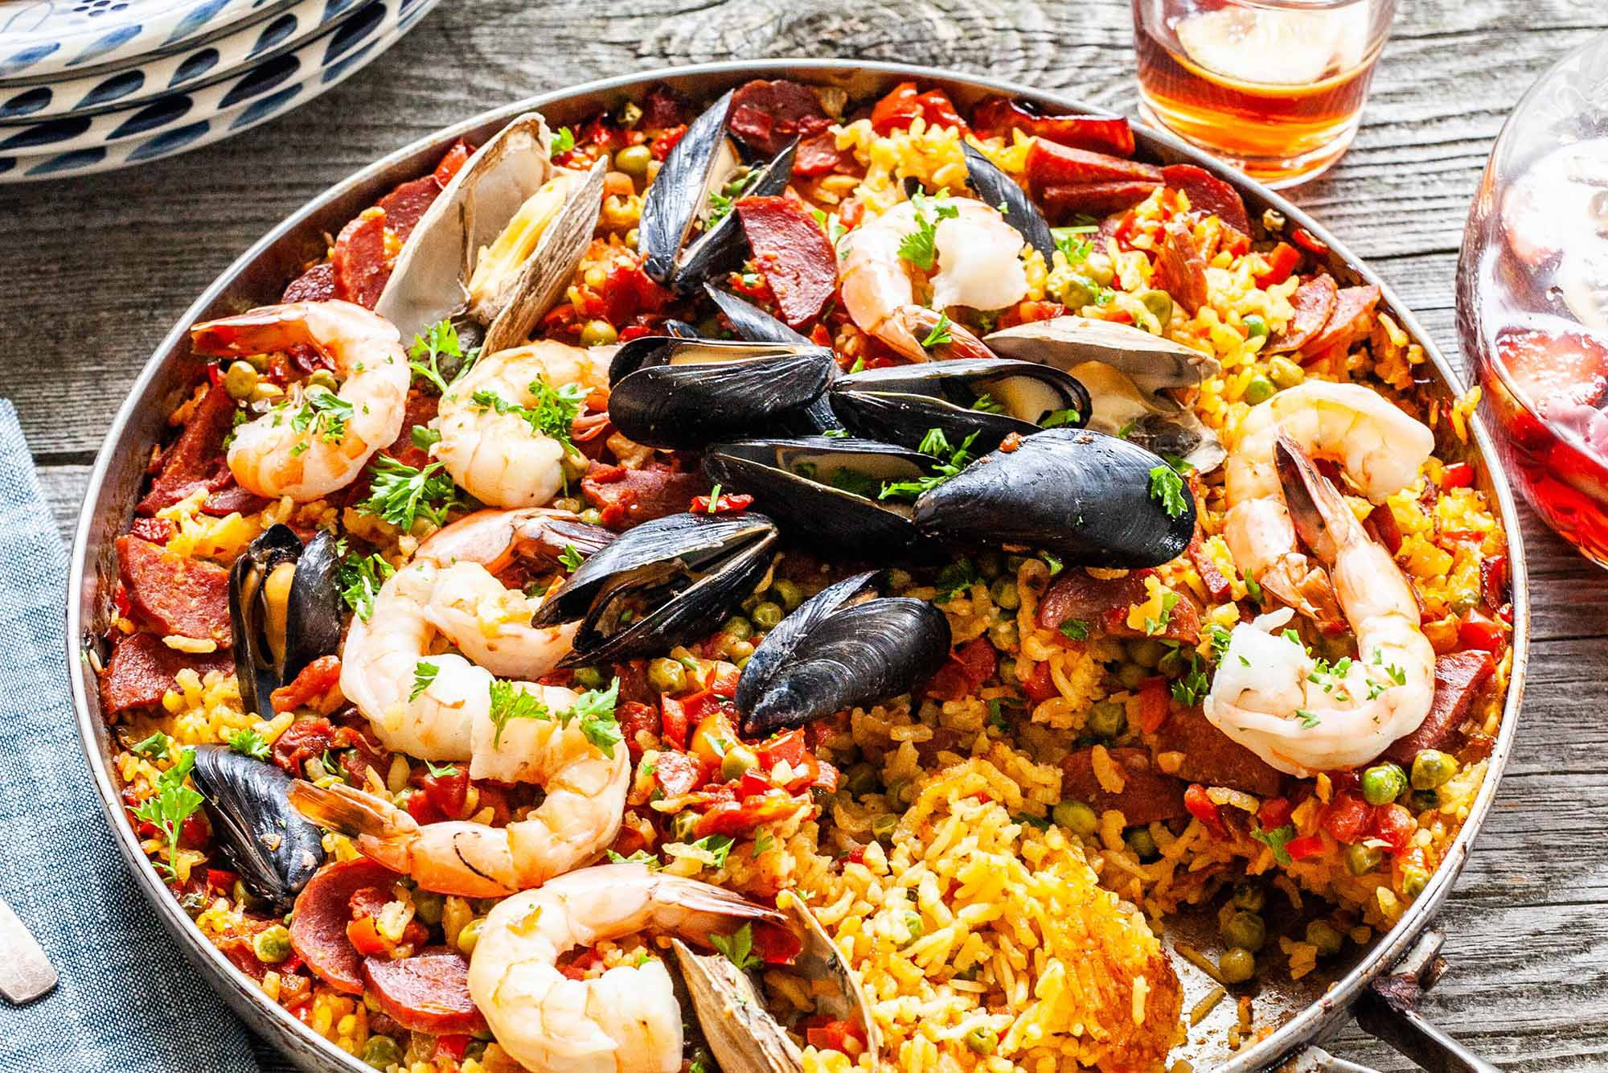
Application of Models
Test Application
Paella
Paella
Model Prediction: 1.0
Cheesecake
Model Prediction: 2.447e-08

Slide 48
Application of Models
Test Application

Slide 49
Summary
Use of different Optimizers
Use of different normalization techniques
Changing of Decay Rate
Use of other prebuilt models
Experimentation with K-Fold Cross validation
Analyzing MobileNetV2 in detail

Slide 50
Thank You!
Nicolas Teo Zhi Yong
S10206093B
P02

